Slide 1

Project 7
Complete Your Java Back-End to Make Your Application More Secure

Slide 2
Summary
Objective of the project
The technical stack of this application
Requirements/Features
SureFire Report
Jacoco Coverage Report

Slide 3
The technical stack of this application
The main goal of the project is to finish building the core engine for the Poseidon application, in which basic entities were provided that will be used to generate the trades.
Back-end logic
Java and Spring Boot Framework
Spring Security
Maven
Thymeleaf
Database management system
MySQL

Slide 4
Requirements/Features
Implement the CRUD methods for six (6) entities: Curve Point, Ratings, Rules , Trades, Users, Security
Whenever a user connects to an endpoint, add logs in a code.
Use field validations, especially for numeric fields (only numbers) and for passwords (at least one uppercase letter, minimum eight characters, at least one number, and one symbol).
Implement the session-based method of authentication for security.
Test code.

Slide 5
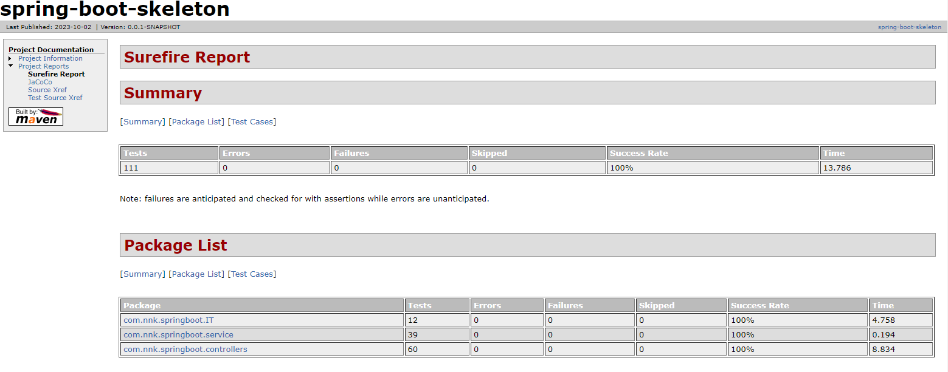
Surefire Report

Slide 6
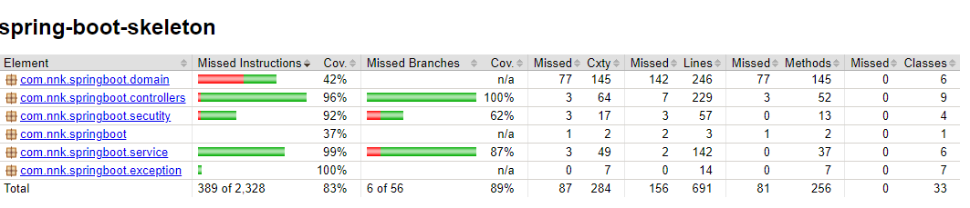
Jacoco Coverage Report

